Slide 1
APPLICATIONS OF DRONE

Slide 2
BHOOMIKA
Drones, yaani unmanned aerial vehicles (UAVs), bahut saari industries mein use hote hain kyunki ye aise kaam kar sakte hain jo insaan ke liye mushkil, dangerous, ya inefficient hote hain. Yahaan kuch key applications ka brief overview hai:

Slide 3
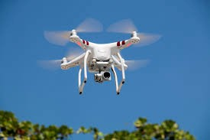
APPLICATIONS OF DRONE
Aerial Photography aur Videography
Media aur Entertainment: Filam,advertisement aur events ke liye sundar aerial shorts capture karna.
Real Estate: property ke unique photos aur angles dikhakar listing ko behtar karna.

Slide 4
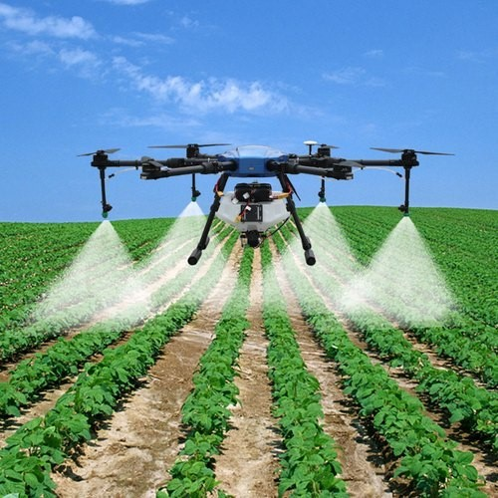
APPLICATIONS OF DRONE
Agriculture
Crop Monitoring: Fasal ki sehat ka endaza lagana aur multispectral imaging se growth monitor karna.
Precision Agriculture: Pani khaad aur chemicals ka sahi aur prabhav upyog karna, kyuki drone detail field data collect karte hain.

Slide 5
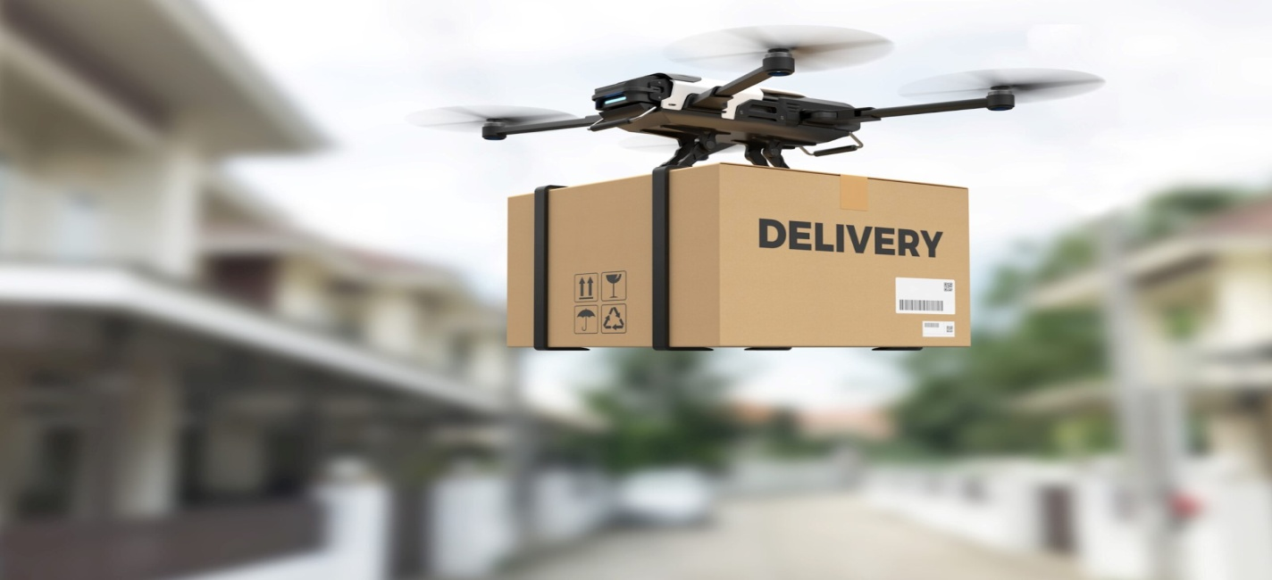
APPLICATIONS OF DRONE
Delivery Services
E-commerce: Shehri ilaakon mein chhote packages ko tezi se deliver kana, jaise Amezon aur UPS jaise companies karti hain.
Medical Supplies: Door-daraaz ya muskhil ilaakon mein zaroori medical saman aur samples pahunchana.

Slide 6
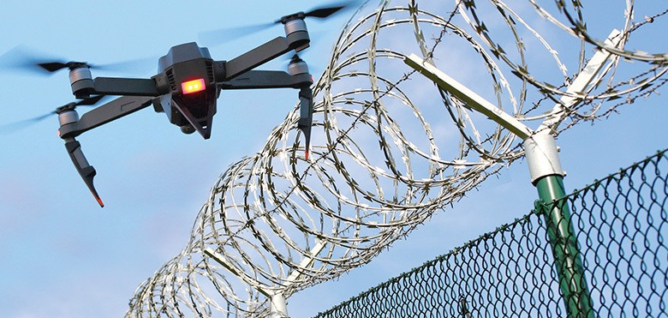
APPLICATIONS OF DRONE
Surveillance aur Security
Law Enforcement: Large events, traffic monitor karna aur surveillance operations conduct karna.
Border Control: Borders patrol karna aur unauthorized crossings identify karna.

Slide 7
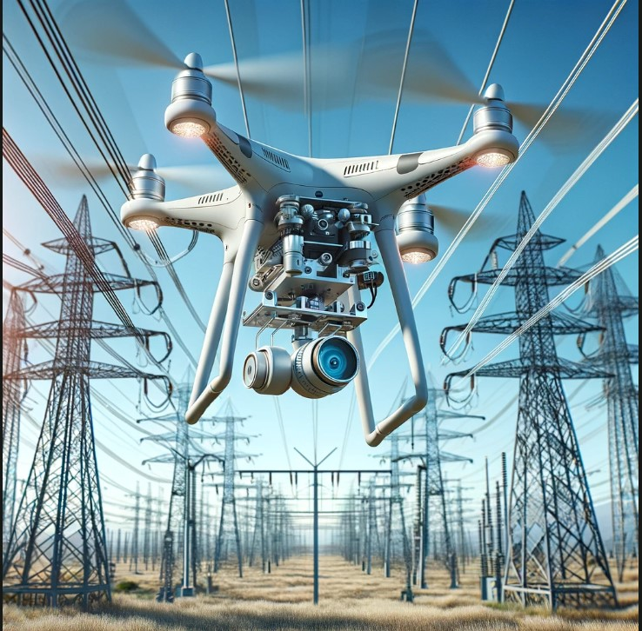
APPLICATIONS OF DRONE
Inspection aur Maintenance
Infrastructure: Bridges, power lines, wind turbines, aur pipelines inspect karna to detect damage ya wear without risking human lives.
Construction: Construction sites aur progress monitor karna aur safety compliance ensure karna.

Slide 8
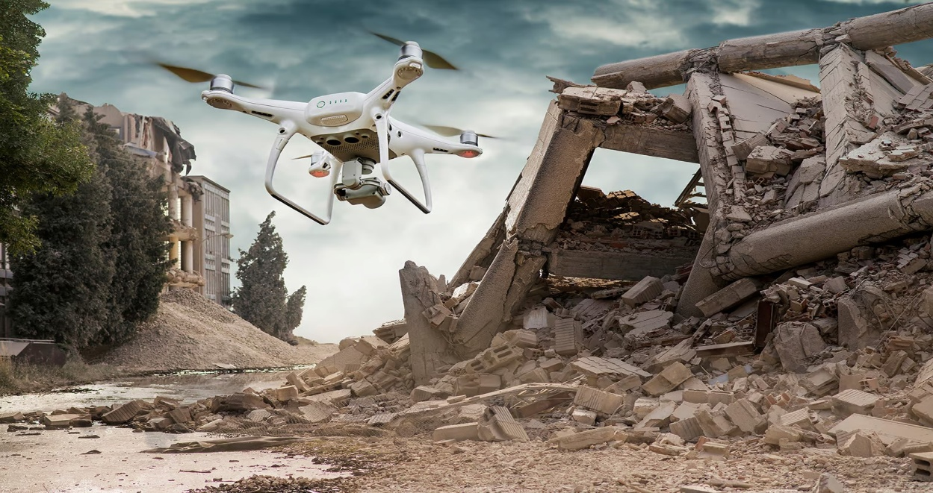
APPLICATIONS OF DRONE
Disaster Management
Search and Rescue: Natural disasters ya accidents ke dauran hard-to-reach areas mein victims locate karna.
Damage Assessment: Disaster ke baad quickly damage ka extent assess karna for efficient response planning.

Slide 9
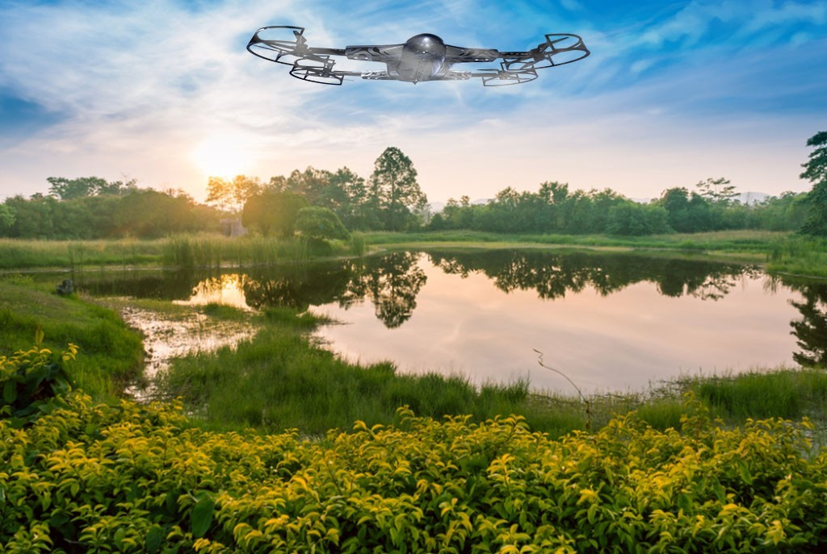
APPLICATIONS OF DRONE
Environmental Monitoring
  Wildlife Conservation: Animal populations track karna, migration patterns monitor karna, aur poaching activities detect karna.
  Pollution Monitoring: Real-time mein air aur water quality measure karna aur pollution sources aur levels ko detect karna.

Slide 10
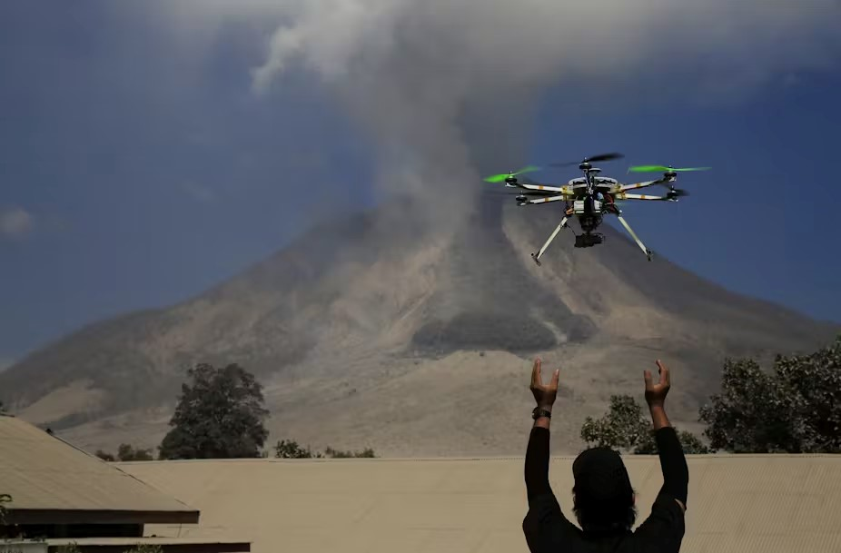
APPLICATIONS OF DRONE
Scientific Research
  Climate Studies: Lambe samay tak ke weather ko padh kar samajhna jaise tapman mosam,hawa ke pettren kaise badal re hai

Slide 11
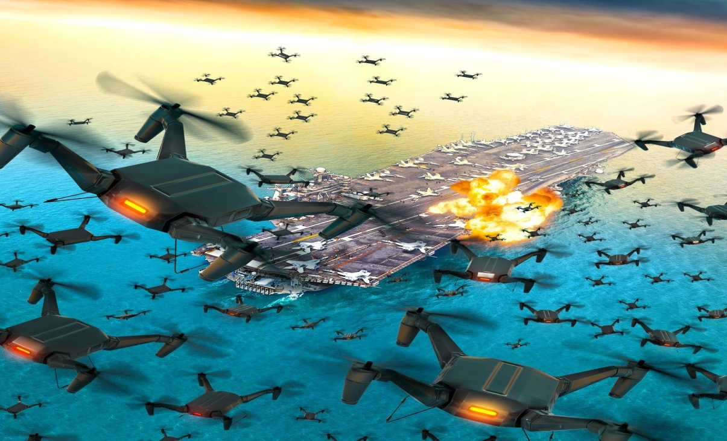
APPLICATIONS OF DRONE
Military aur Defense
  Reconnaissance: Conflict zones mein intelligence gather karna aur surveillance missions perform karna.
  Combat: Targeted strikes conduct karna with minimal risk to human soldiers.

Slide 12
SENA DRONE KA ISTEMAL
SENA MEIN DRONE KA ISTEMAL
Built-up area ki recce.
Recce tps ke dwara dushan ki gatividhi par dhyan rakhna.
Fwd tp ke dwara age ke area ki recce.
Dushan ke area ki photo lena jis se apne tps ke advance ko behatr tariqe se kar saken.
Demonstration ke dauran vip ko tps ki movements ko dikhana.
Senior cdr ke dwara ex mein tps ki movement ko control karna.
Pani ke andar pani ke jahaj aur sum marine ki maintenance karna
Arty tps ke dwara dushman ki location ka GR lena

Slide 13
ENEMY KE DRONE SE KHATRE
ENEMY KE DWARA DRONE SE NIMIN KHATRE HO SAKTE HAIN:-
Larai ke samay hamari gati vidhiyon par dhyan rakkhan.
Hamare kisi bhi camp par bomb gira sakta hai.
Tps ke advance ki pal – pal khabar rakh sakta hai.
Hamare fence ko bomb gira kar tor sakta hai.
A & B veh Colum ko nuksan pahucha sakta hai.
Hamare ilaqe mein propaganda bomb gira kar hamare ko bhramit kar sakta hai.

Slide 14
ENEMY KE DRONE SE BACHNE KE UPAY
Tps ke advance ke samay ek tk ko op ke taur par detail rakhen.
Jab bhi column ka halt hota to drone ke khatre se bachane ke liye op tk par NSVT load honi chiye
Tps ka advance line head formation mein nahin hona chahiye.
Apni BOP par achhe qism ki sight ke sath nigarani honi chahiye.
Agar ho sake to fwd tps ke pass ya recce tps ke pass drone ka bandobast hona chahiye jisse dushaman ki aisi gati vidhiyon par dhiyan rakh saken.

Slide 15
EN KE DRONE KO AQUIRE KARNE KE TARIKE
Tk mein lagi Sight ki madad se har samay drone ke attack se bachane ke liye search karte rahen.
Tp ke ander ek tk ko drone ke khatre se bachane ke liye nominate rakhen.
Camp ke ander ek ya do MMG/LMG post org karen.
BOP ke uper bhi achchhe qism ke sight ka bandobast rakhen, jisse dushman ka drone LOC/IB ko cross na kar saken.
Tk ke uper latest aise sadhan ho jo ki drone ke khatre ko pahle se hi malum kar saken. Ex - Zen Tech Anti Drone Sys.

Slide 16
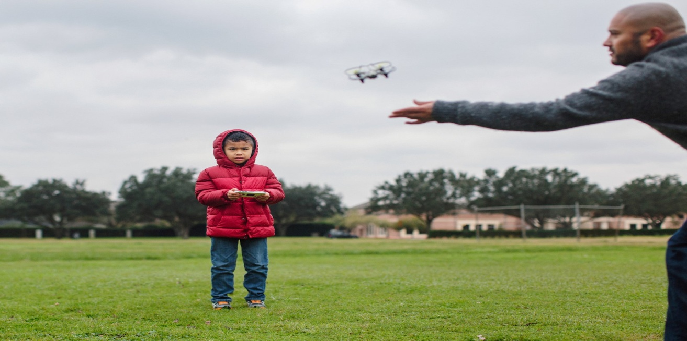
APPLICATIONS OF DRONE
Recreational Use
Hobbyist Flying: Recreational drone flying aur racing mein engage karna.
Aerial Sports: Drone racing leagues aur competitions mein participate karna.

